Slide 1

SESSION-8:
S3

Slide 2
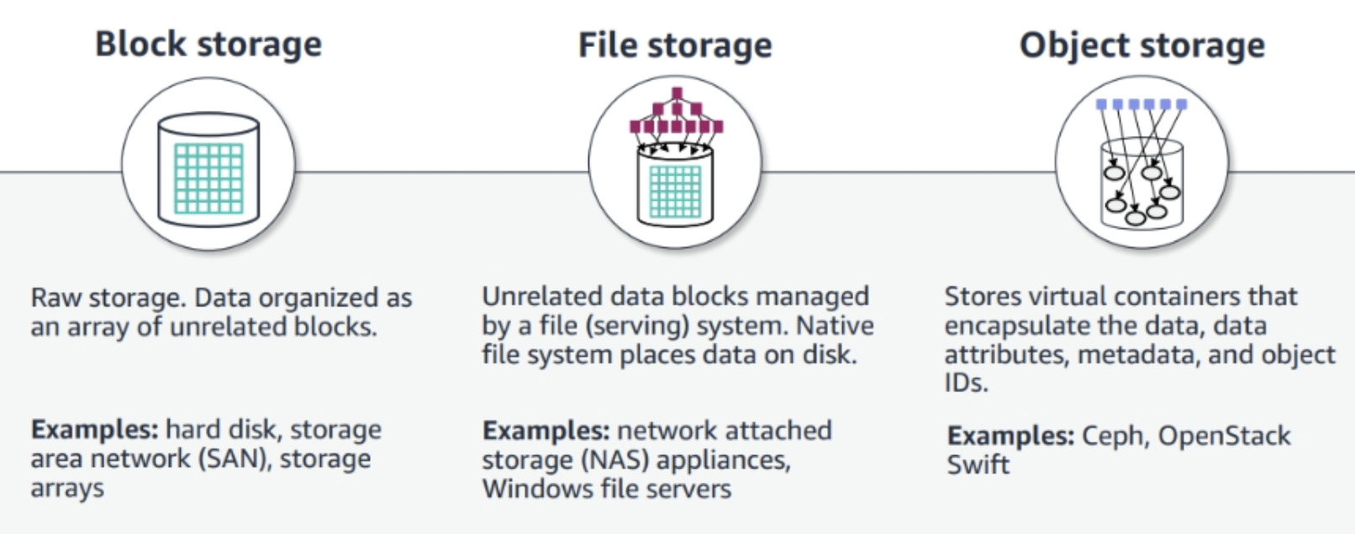
AWS Cloud Storage

Slide 3
AWS Storage Services
For Block Storage: Amazon Elastic Block Store (Amazon EBS)
For File Storage: Amazon Elastic File System (Amazon EFS), Amazon FSx
For Object Storage: Amazon Simple Storage Service (Amazon S3), Amazon S3 Glacier

Slide 4

AWS S3
It is a durable object storage solution.
Reduce Cost
Increase Agility
Accelerate Innovation
Strengthen Security
Cost factors: Storage Type, Replication, Versioning, Data Transfer, Requests and Retrievals, Management and Analytics

Slide 5
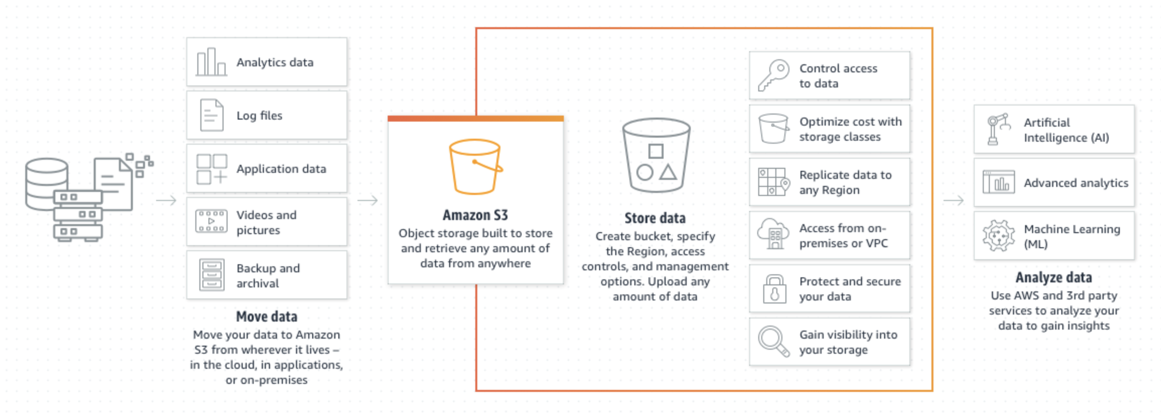

Slide 6

AWS S3 - Bucket and Object Names
Data is stored as an object in the bucket.
An object includes a file and any metadata that describes the file.

Slide 7
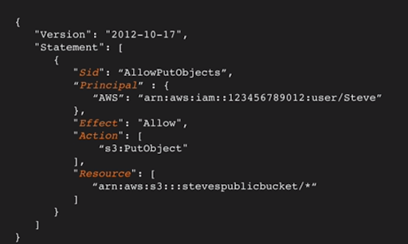
AWS S3 - Bucket Policies
Resource-based policy for an S3 bucket in JSON format
Controls access without managing permissions in AWS IAM

Slide 8
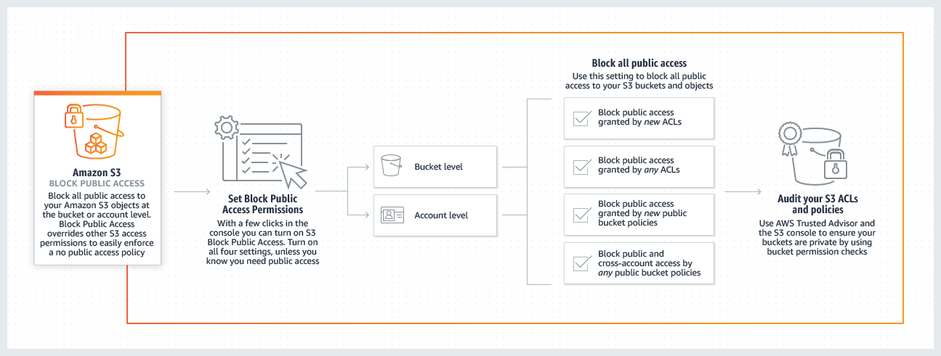
AWS S3 - Block Public Access

Slide 9
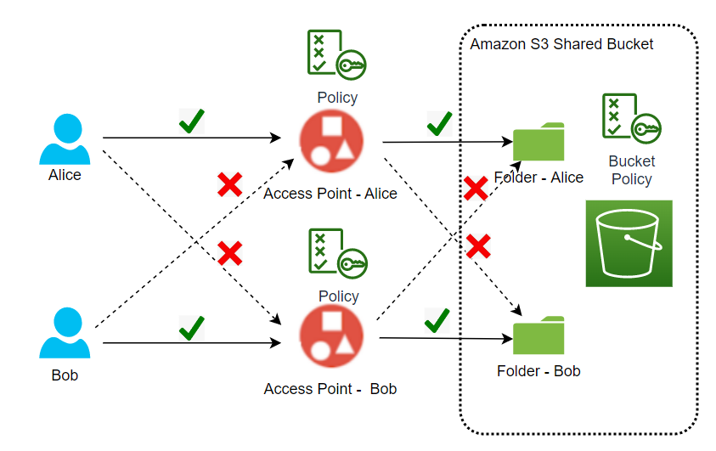
AWS S3 - Access Points
Each access point has unique Domain Name System (DNS) and Amazon Resource Name (ARN)
Access points have distinct permission ve network controls

Slide 10
AWS S3 - Server Side Encryption Key Types
Amazon S3-managed keys (SSE-S3)
AWS KMS keys (SSE-KMS)
Duel-layer server-side encryption (DSSE-KMS)
Customer-provided keys (SSE-C)

Slide 11
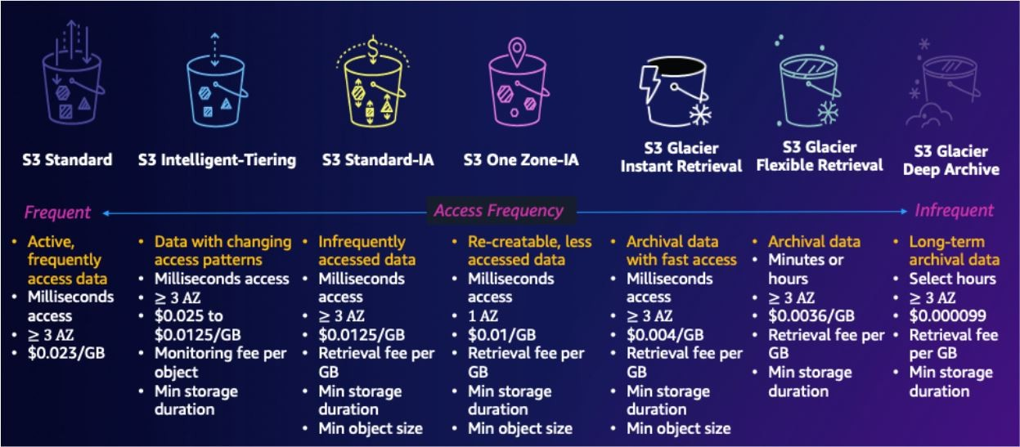
AWS S3 - Storage Classes

Slide 12
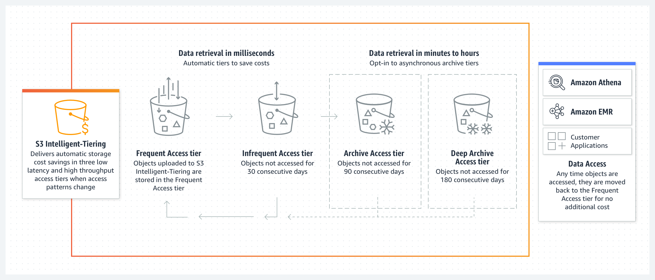
AWS S3 - Intelligent Tiering

Slide 13
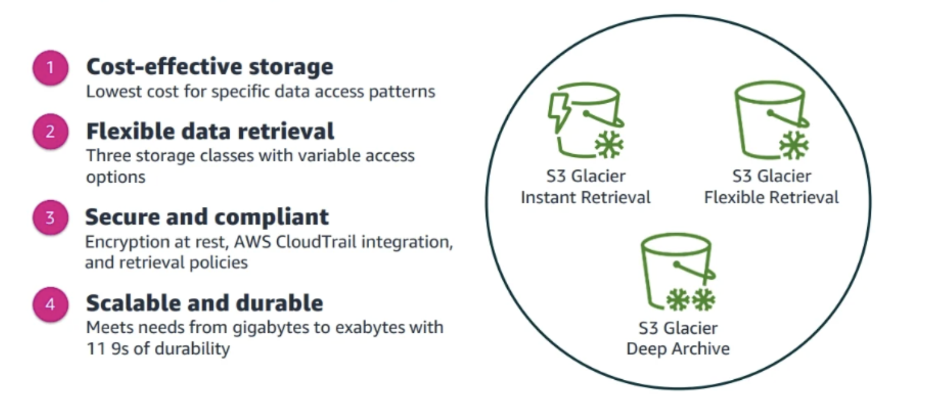
AWS S3 - Glacier

Slide 14
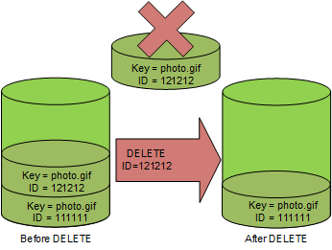
AWS S3 - Versioning
Keep multiple variants of an object in the same bucket.
Restore an object to a previous or specific version.
Use S3 Object Lock for data retention or protection.

Slide 15
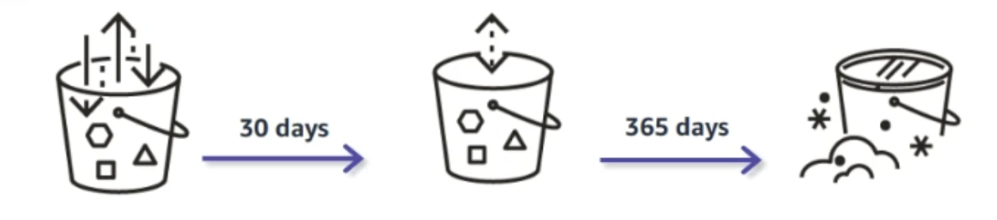
AWS S3 - Lifecycle Policies
S3 Lifecycle policies are used to transition objects to another storage class. S3 Lifecycle rules take action based on object age.
Example: Move objects older than 30 days to S3 Standard-IA, Move objects older than 365 days to Amazon S3 Glacier Deep Archive.

Slide 16
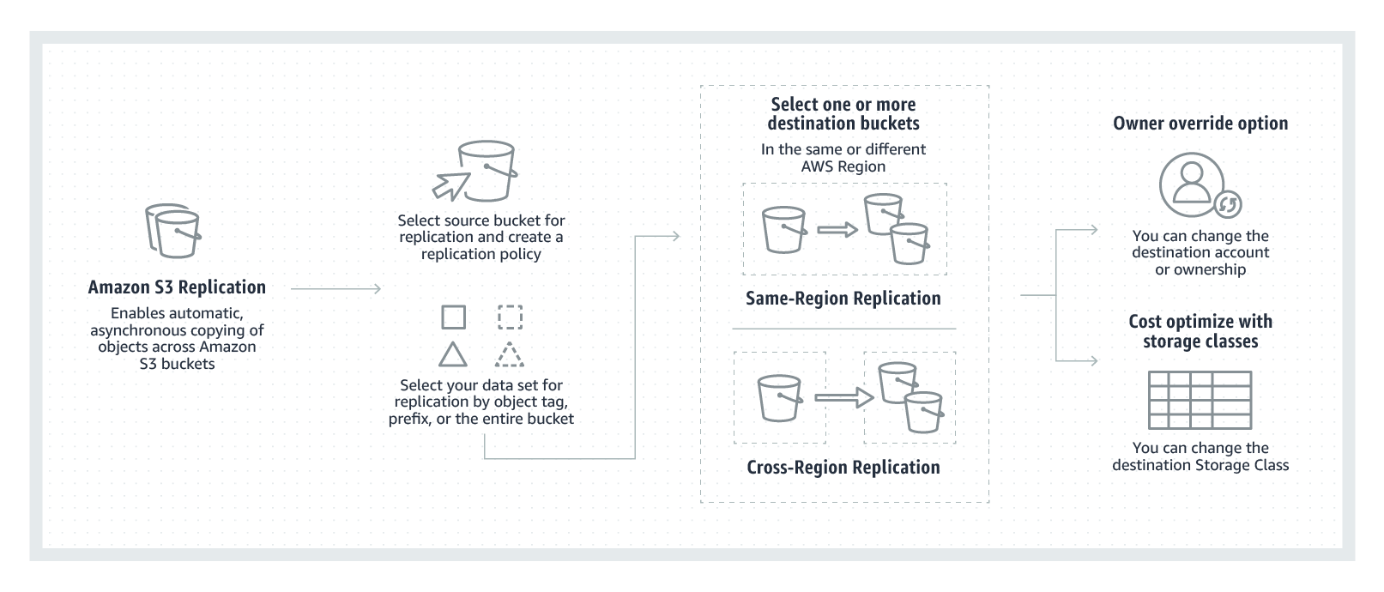
AWS S3 - Replicating Objects

Slide 17
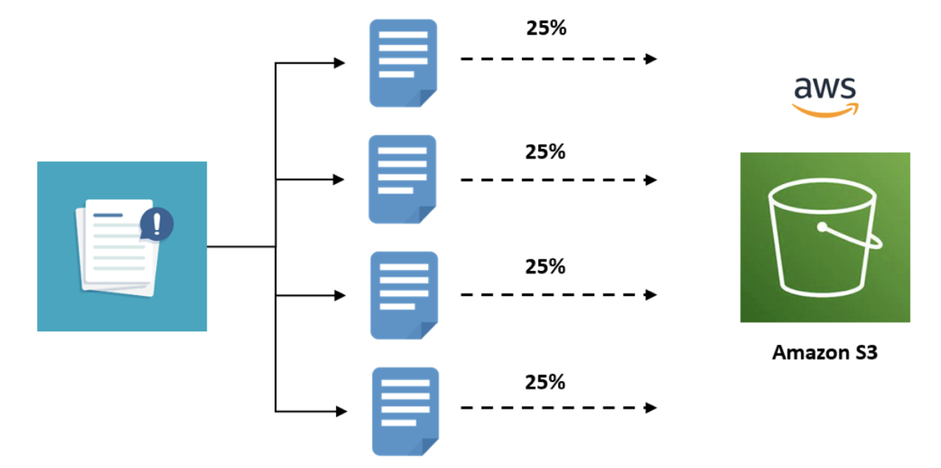
AWS S3 - Multipart Upload
Initiate the upload, upload the object parts and complete the multipart upload.

Slide 18
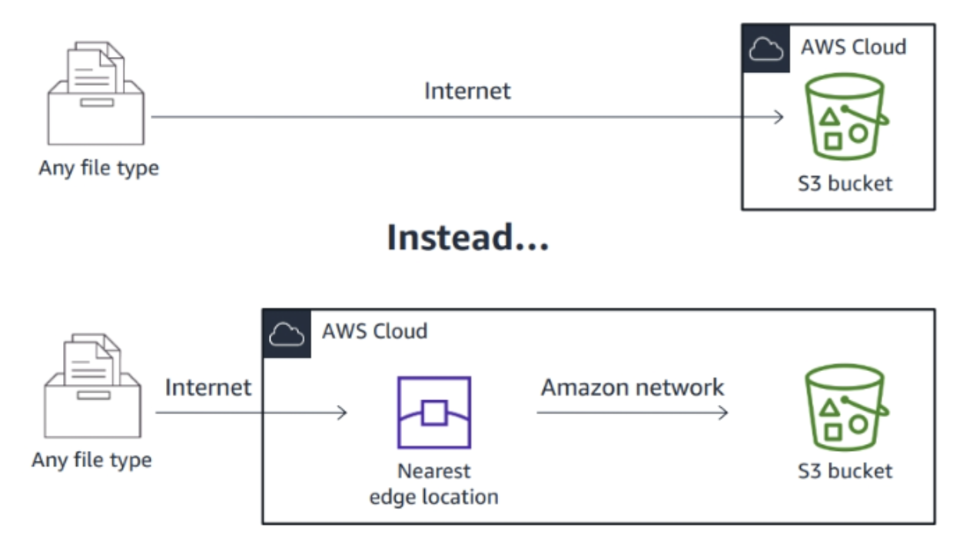
AWS S3 - Transfer Acceleration
Move data faster over long distances.
Reduce network variability.

Slide 19
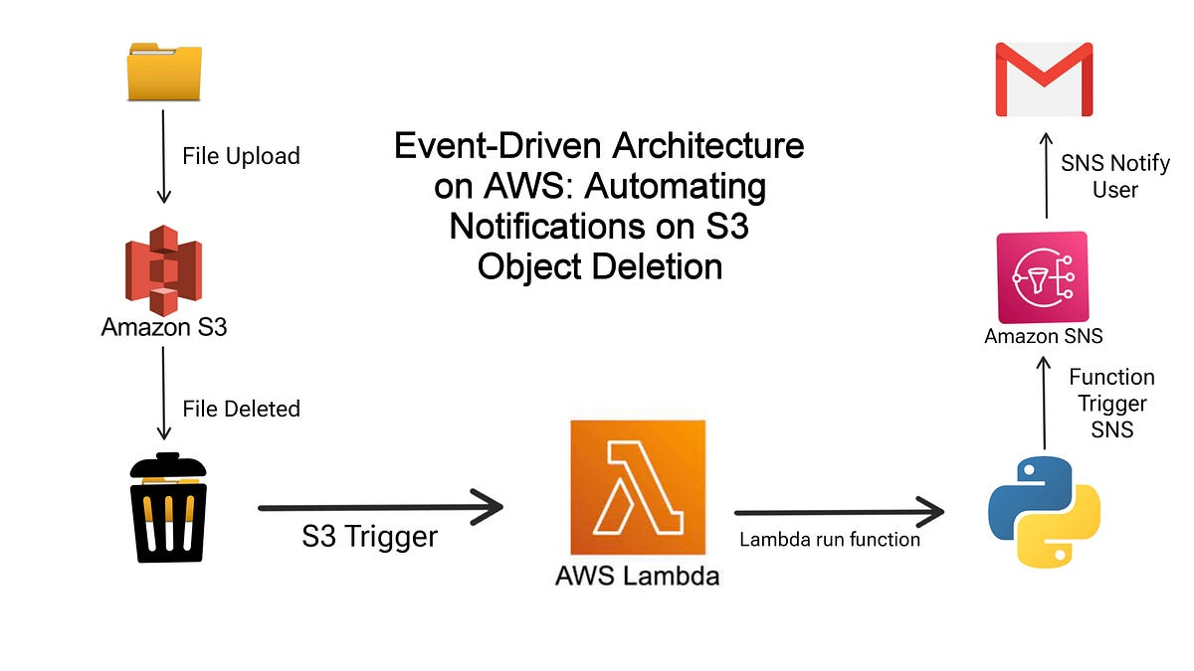
AWS S3 - Event Notifications
Get notifications sent when events happen in your S3 bucket.
Let AWS manage event monitoring: no polling needed.

Slide 20
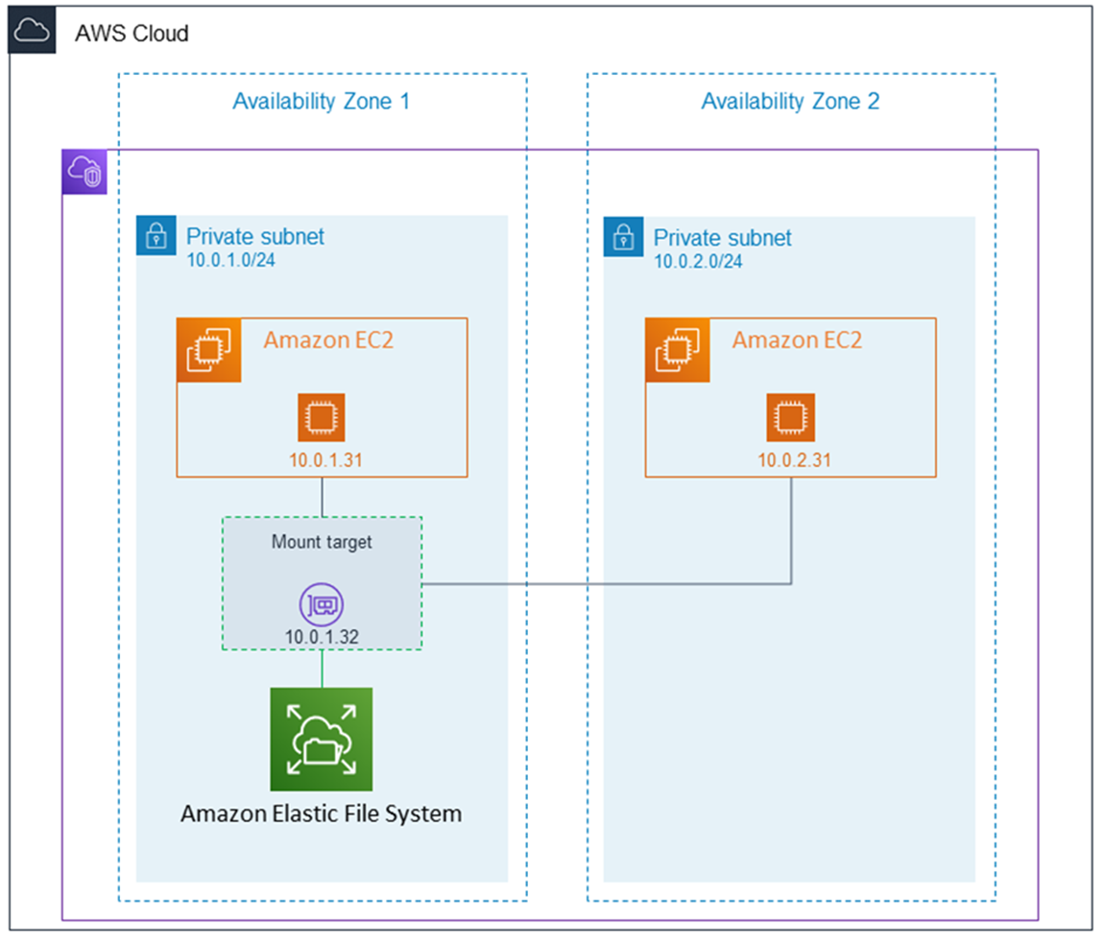
Amazon EFS
It is used if multiple instances need to use the same storage.
Files systems are accessed from EC2 instances at the same time.
File systems are connected by using the NFSv4 protocol.

Slide 21
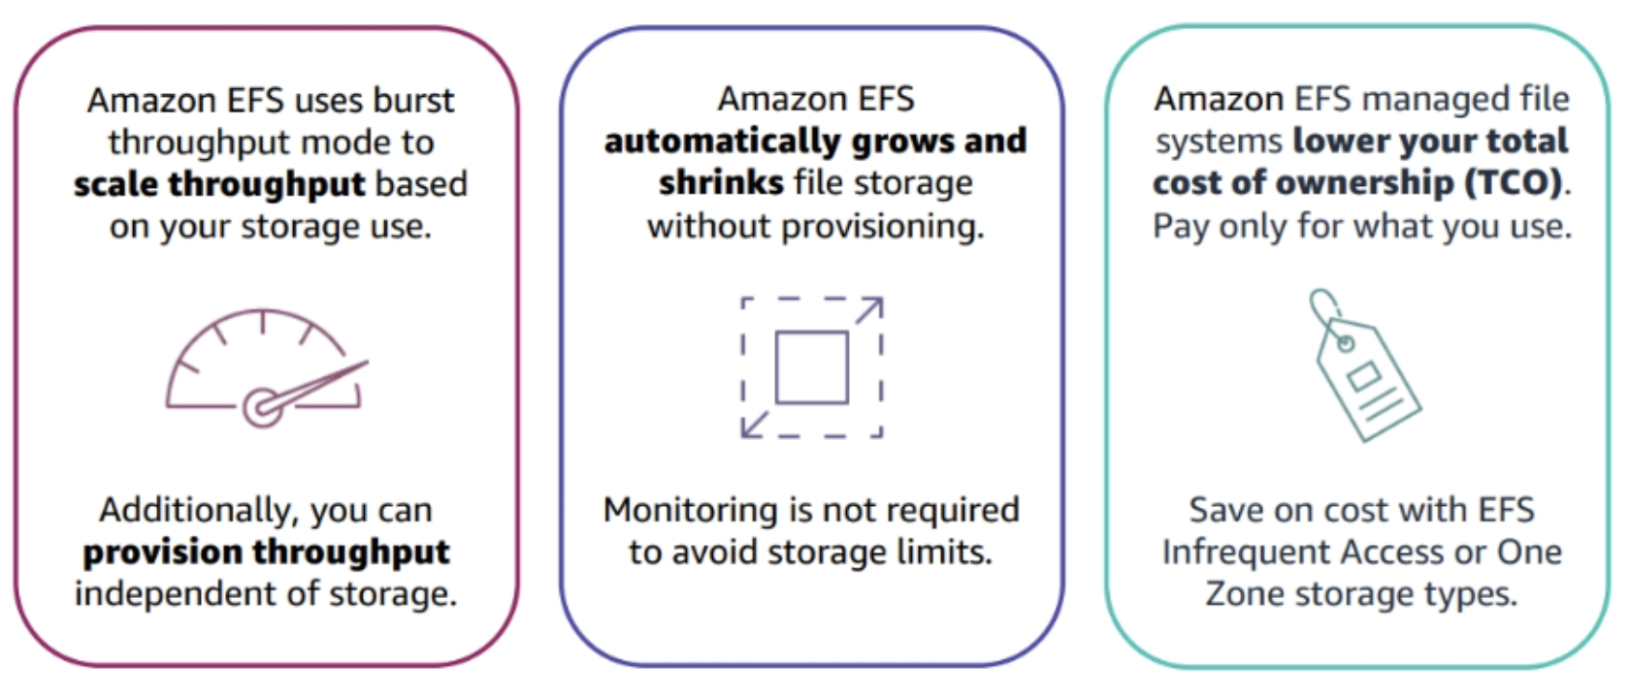
Amazon EFS Benefits

Slide 22

Amazon FSx
Launch, run, and scale high-performing file systems on AWS.
Use familiar and feature-rich products without managing hardware provisioning, patching and backups.
Amazon FSx for Windows File Server, Amazon FSx for Lustre, Amazon FSX for NetApp ONTAP, Amazon FSx for OpenZFS

Slide 23
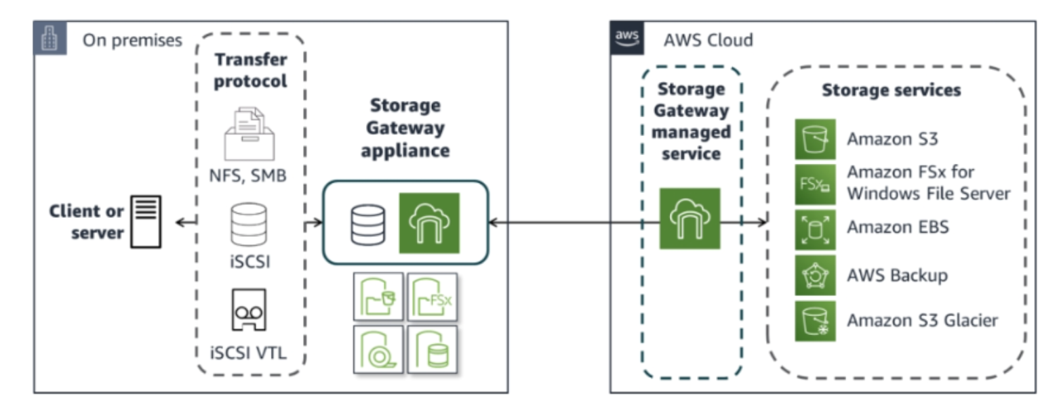
AWS Storage Gateway

Slide 24
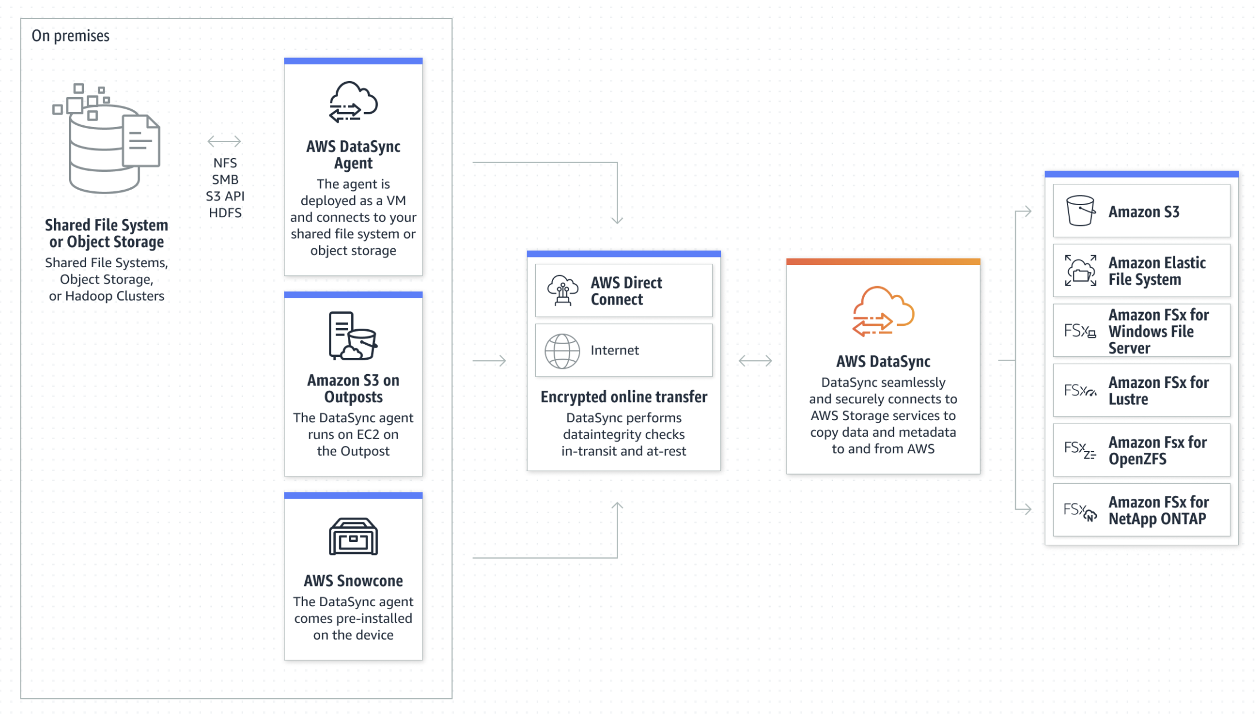
AWS Data Sync

Slide 25
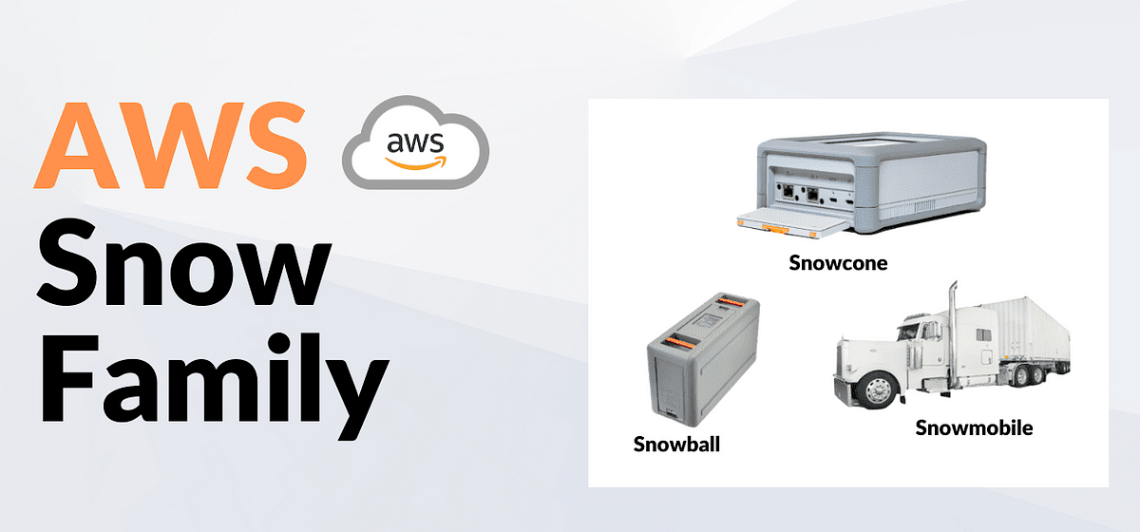

Slide 26
THANKS FOR LISTENING

